Slide 1
Phoenix AISES General Meeting- March 2019
03/31/2019 @ 6:30pm-8:30pm
Native Health

Slide 2
Mission of AISES
To increase substantially the representation of American Indians, Alaskan Natives, and Hawaiian/Pacific Islanders in engineering, science, mathematics, and other related technology disciplines.

Slide 3
Agenda
Call to Order
Introductions
Secretary’s Report
Treasurer’s Report
New PHX AISES Website
2019 PHX AISES Scholarship
2019 Golf Tournament
Social Events
Volunteering
Other Announcements
Committee Breakout Sessions
Adjournment

Slide 4
Introductions
2019 Executive Board
Member introductions

Slide 5
Secretary’s Report
Board Meetings
02/07/2019
02/28/2019

Slide 6
Treasurer’s Report
Switching of account holder to from 2018 board to 2019 board

Slide 7
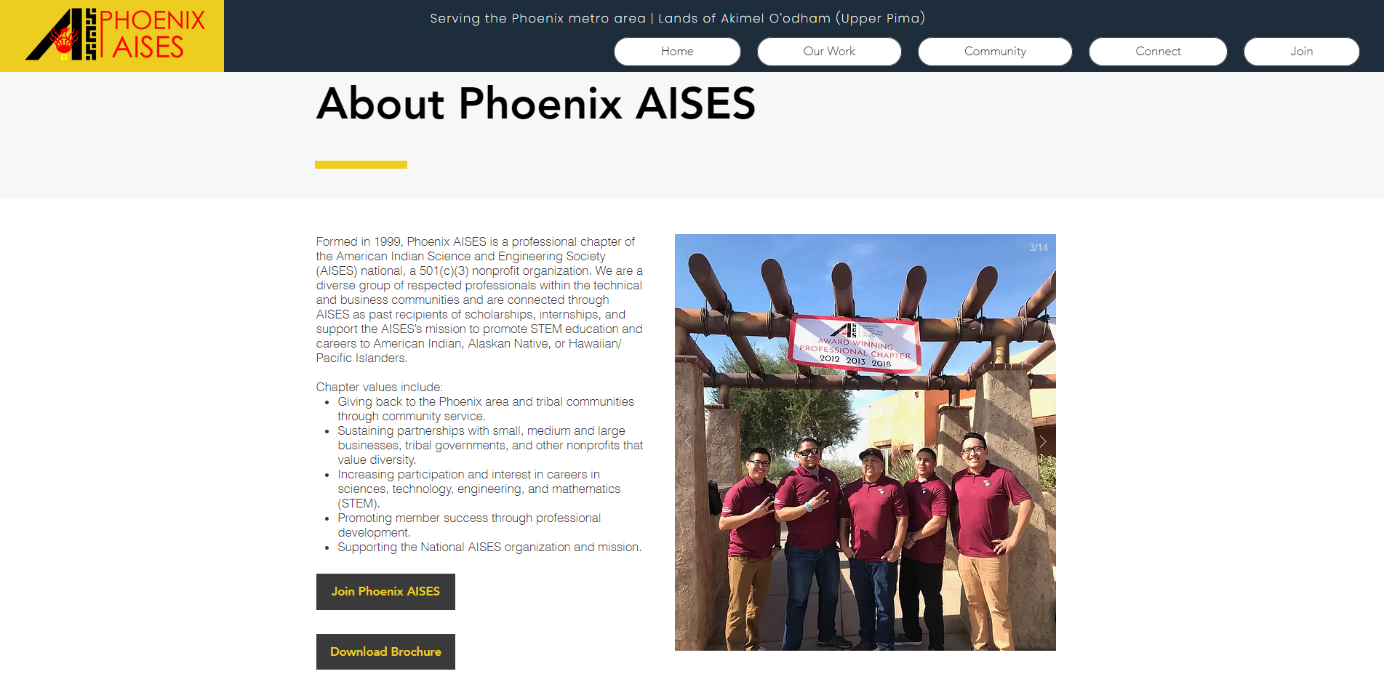
New PHX AISES Website
www.phxaises.com
Designed by Leon Begay
leonbegay2014@gmail.com
Thank You!
Inquiry Section
Member Highlights
Download Calendar
Review General Meeting Presentations

Slide 8
2019 PHX AISES Scholarship
Who can apply:
Incoming Fall 2019 Freshman
$500 Scholarship
Current Enrolled College
$1000 Scholarship
Must be Full-Time Student (12 credit hours)
Must be a National AISES Member
Must Complete Application
Deadline: Posted Mark by June 30th, 2019
Need Volunteers for the Scholarship View Committee
Email phxaises1@gmail.com for more information

Slide 9
2019 Golf Tournament
Working on obtaining a venue
Target in September and November
Need Sponsors
Accepting Donations
Need Volunteers
Planning
Fundraising
Running the event
Email phxaises1@gmail.com for more information

Slide 10
Social Events
Networking Night:
03/28/2019 @ Four Peaks Brewery (Tempe)
Bowling Night:
Tentatively for the second week of April
More information to be announced

Slide 11
Volunteering
STEAM Day
ASU AISES Partnership
Caser Chavez High School
03/30/2019 from 12pm to 3 pm
Update: Postposed
Feed My Starving Children
Tentatively for April 18th
2 hours in the evening
Email phxaises1@gmail.com for more information

Slide 12
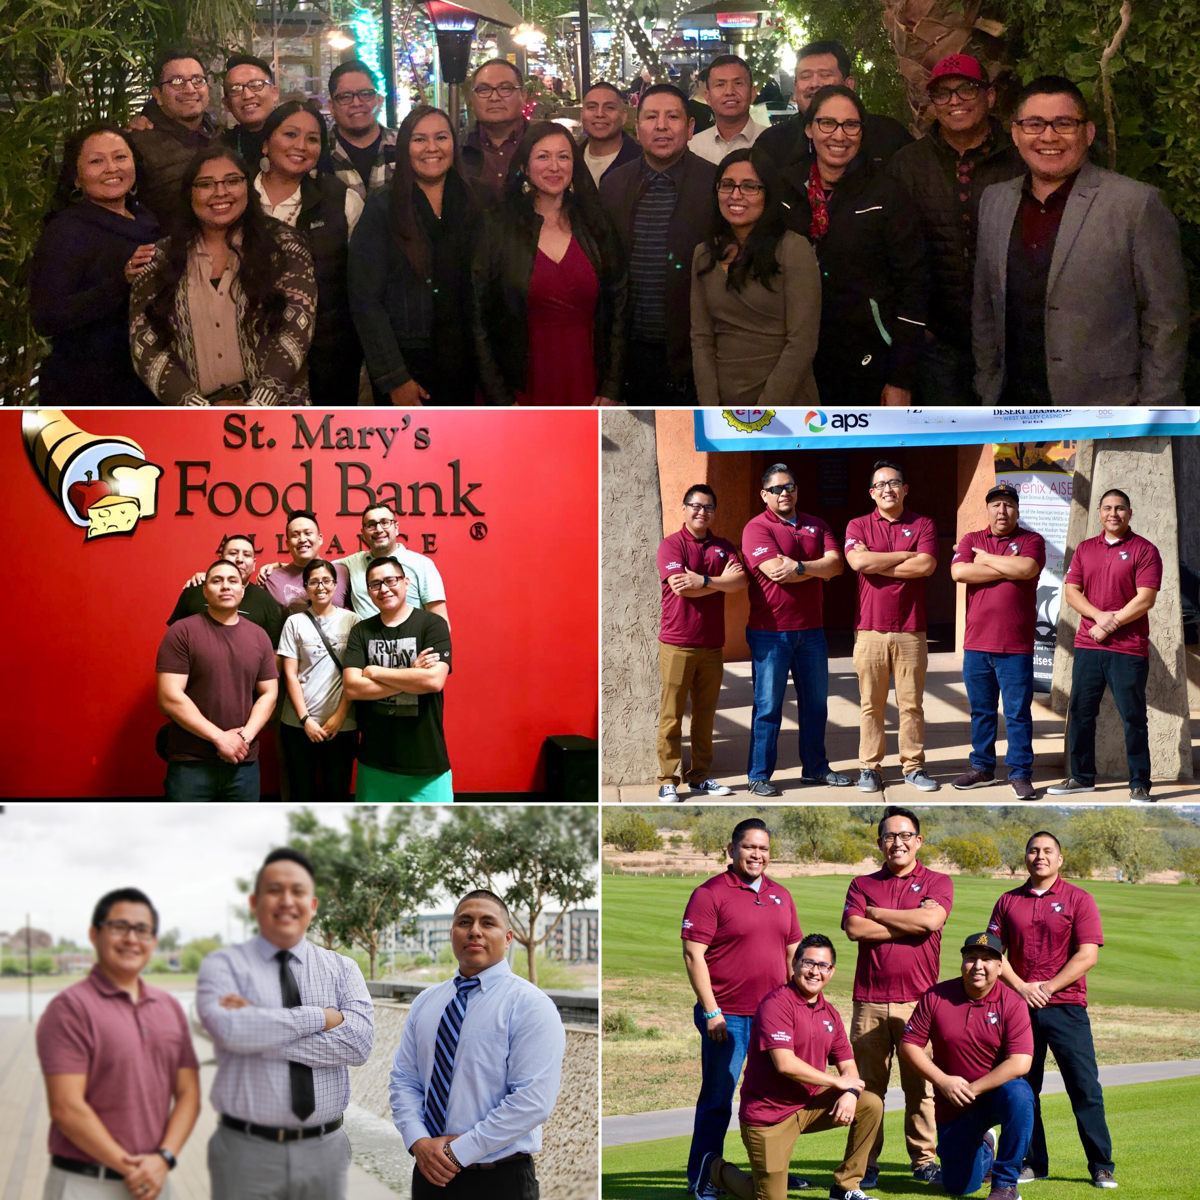
Member Involvement
Join a Committee
Golf Tournament
Scholarship
Attend General Meetings
Attend Social Events
Attend Volunteering Events

Slide 13
Other Announcements
National AISES Membership Drive (Deadline March 31st)
Professionals ($25), College Students ($5), and Free for Pre-college
http://www.aises.org/membership
NASEP Program (U of A). Application deadline March 27th
ASU Native American Alumni Chapter (NAAC)
Quarterly board and elections meeting, March 31st @ 12PM
Annual Spring Breakfast & Social, April 13th @ 9AM

Slide 14
Stay Connected
Like the Phoenix AISES Page
@phxaises
@phxaises
Phoenix AISES
Email phxaises1@gmail.com to be placed on list serv

Slide 15
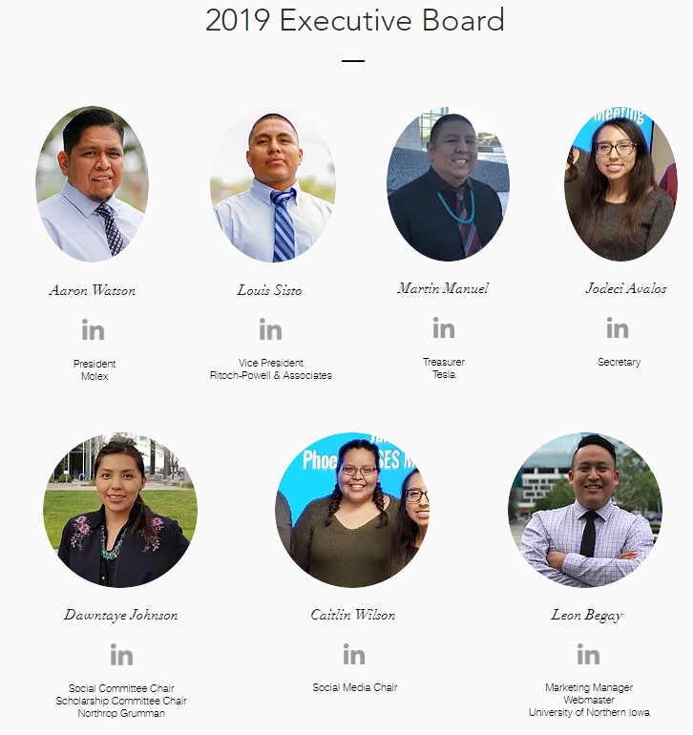
Committee Breakout Session
President/Golf Tournament Committee Chair
Aaron Watson, arnwatson09@gmail.com
Vice-President
Louis Sisto, lsisto@rpaeng.com
Treasurer
Martin Manuel, martinmanuel602@gmail.com
Secretary
Jodeci Avalos, quesha.avalos@gmail.com
Social Chair/Scholarship Committee Chair
Dawntaye Johnson, dajohn21@asu.edu
Social Media Chair
Caitlin Watson, caitlinwatson03@gmail.com
Marketing Manager
Leon Begay, leonbegay2014@gmail.com

